Slide 2
Layout with CSS

Slide 3

CSS Box model
The CSS box model is the foundation of layout on the Web — each element is a rectangular box.

Slide 4
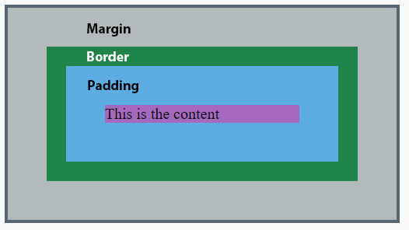

Slide 5
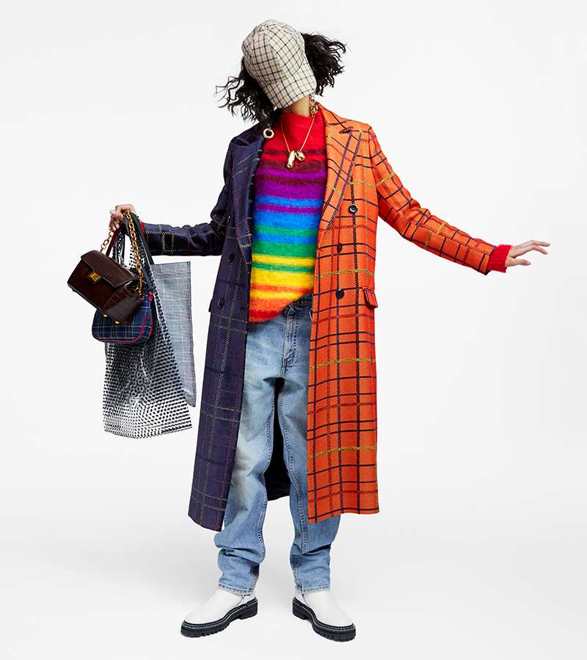
Box display types
Common types
Block
Stacks on other boxes
Can have height and width
Inline
Flows with text
No height and width
Inline-block
Flows with text
Can be sized

Slide 6
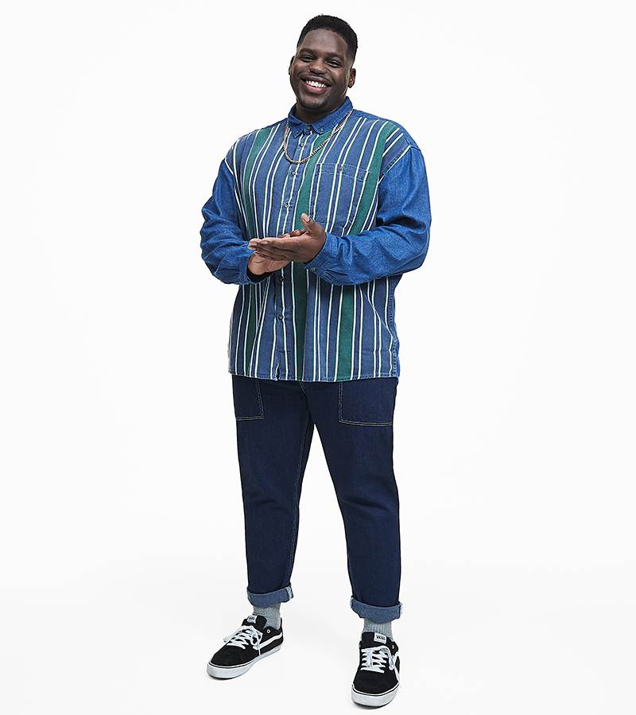
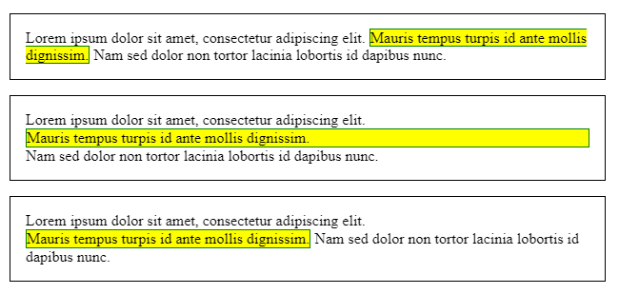
Quiz!
Which is which?

Slide 7

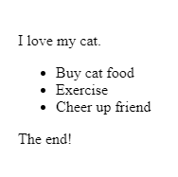
<p>I love my cat.</p> <ul> <li>Buy cat food</li> <li>Exercise</li> <li>Cheer up friend</li> </ul> <p>The end!</p>
Normal flow
<p>I love my cat.</p>
<ul>
<li>Buy cat food</li>
<li>Exercise</li>
<li>Cheer up friend</li>
</ul>
<p>The end!</p>
HTML is displayed in the exact order in which it appears in the source code, with elements stacked up on top of one another

Slide 8
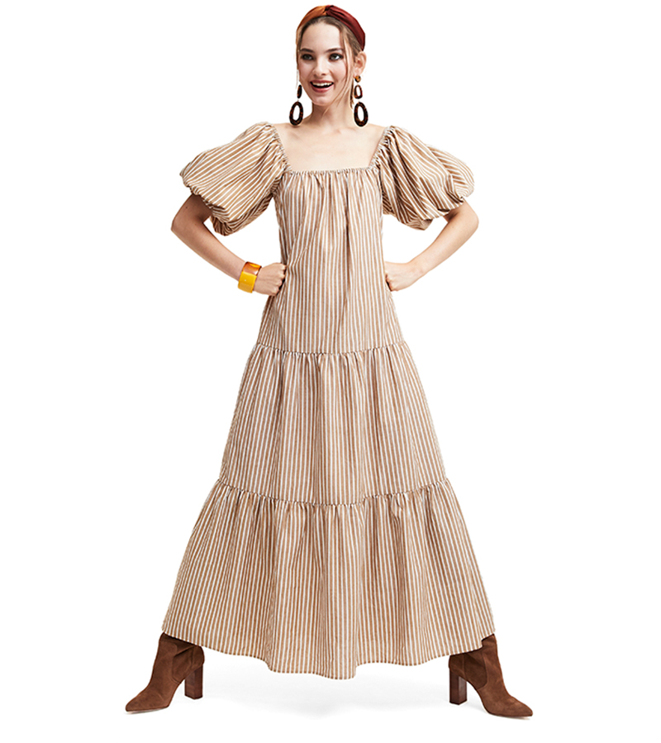
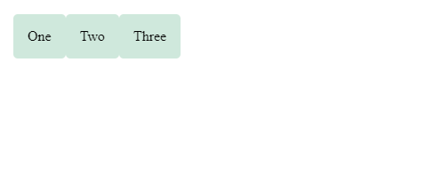
Flexbox
.wrapper { display: flex; }
<div class="wrapper">
<div class="box1">One</div>
<div class="box2">Two</div>
<div class="box3">Three</div>
</div>
Notes:
Flexbox is the short name for the Flexible Box Layout Module, designed to make it easy for us to lay things out in one dimension — either as a row or as a column. To use flexbox, you apply display: flex to the parent element of the elements you want to lay out; all its direct children then become flex items.

Slide 9
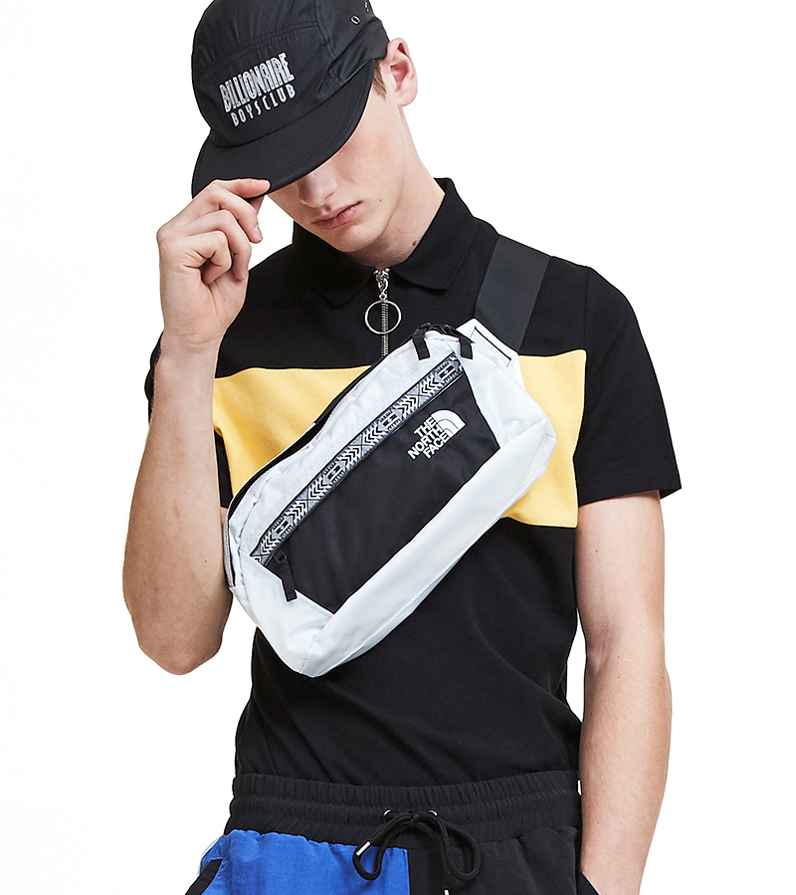
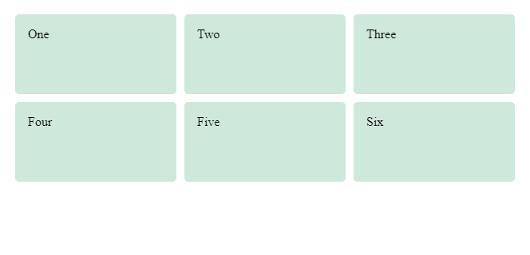
Grid Layout
.wrapper {
display: grid;
grid-template-columns: 1fr 1fr 1fr;
grid-template-rows: 100px 100px;
grid-gap: 10px; }
<div class="wrapper">
<div class="box1">One</div>
<div class="box2">Two</div>
<div class="box3">Three</div>
<div class="box4">Four</div>
<div class="box5">Five</div>
<div class="box6">Six</div>
</div>

Slide 10
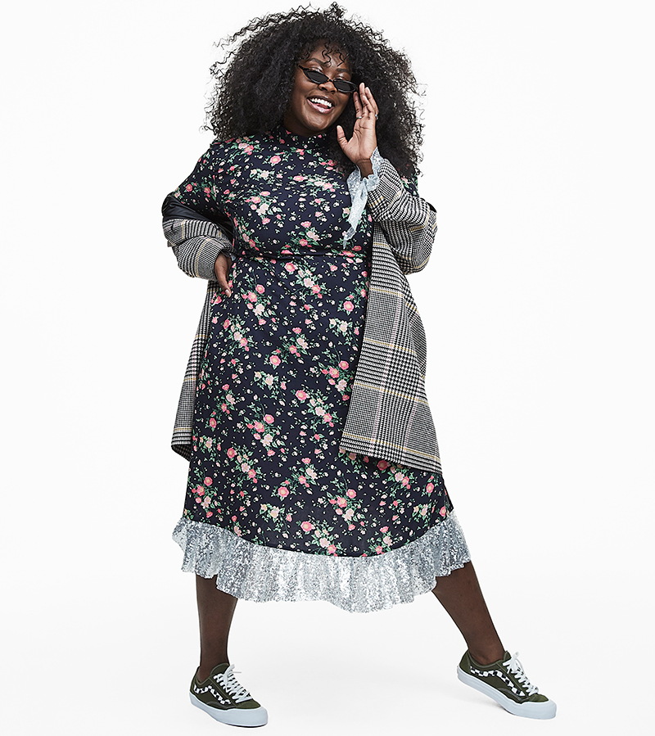
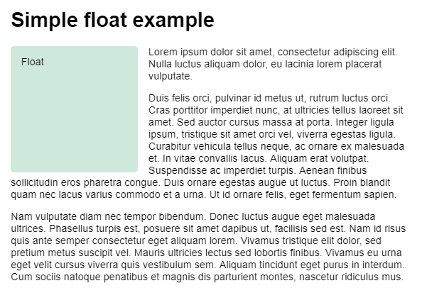
Floats
Originally for adding an image with the text wrapping around it
Has been used to create website layouts
But can use new layouts instead

Slide 11
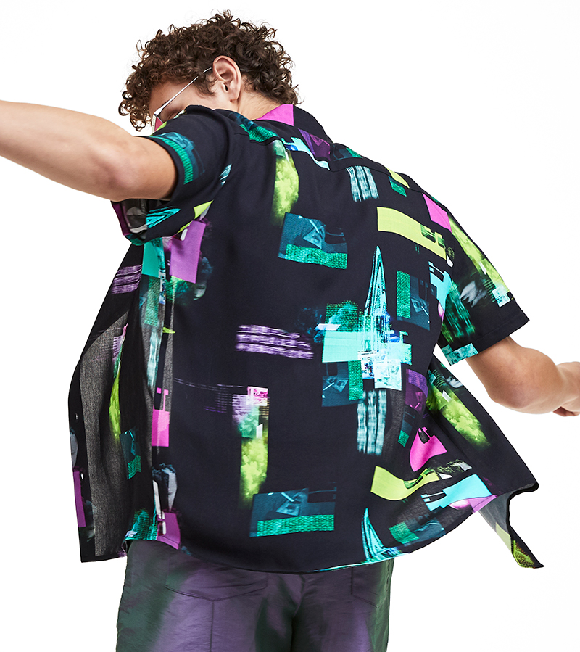
Positioning
Override the basic document flow behaviour
Static – default behavior
Relative – move with top, bottom, left, right
Absolute – specify position
Sticky – relative until scrolled to fixed sticking point (hybrid)

Slide 12



Integration
Add videos and posts from other sites

